Slide 1
Team K ‘Karate Kicking Kangaroos’
James Wilson, James Gormley, Kritika Nautiyal, Jason Kavanagh

Slide 2
Team Responsibilities
James Wilson: Coder/ Testing - Coding/Testing/managing the code.
James Gormley: Coder/ Designer – Coding & choosing/managing suitable design patterns
Kritika Nautiyal: Team Leader/ Documenter - Managing/Documenting project
Jason Kavanagh: Tester/ Planner –Scheduling meetings and completion points of specific tasks.

Slide 3
Decisions
Our decision making is revolved around the group
The team leader organises group meeting’s, so that we our reaching our criteria.
We all as a team agree on the final say, of how the project should be designed and implemented.

Slide 4
Emergencies & Contingencies
We try to contact through social networks e.g. Facebook, and via mobile
If a teammate becomes unresponsive, we have a procedure to assign a replacement role for a teammate

Slide 5
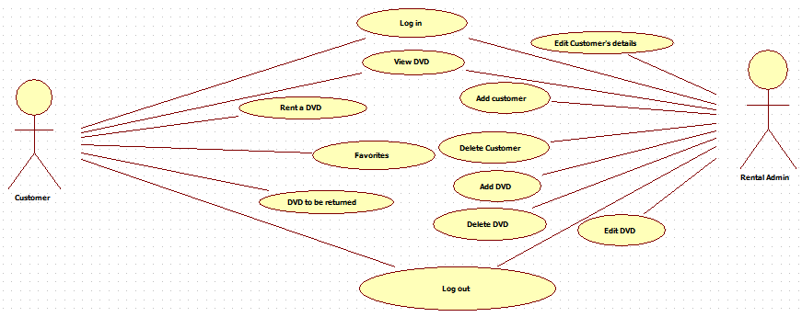
Our Preferred Project: DVD Rental System

Slide 6
DVD Rental System Key Features/ Unique Selling Points
Allow for the Admin to see how many times a film was rented.
The customer can add film’s to their wish list.
Customer can track when the next rental is due for return.
What is the important features a customer & admin will want?

Slide 7
Why is our Team Best Suited
Are team are responsive
Are team is eager to learn more about web design & development

Slide 8
Alternative Projects
Library Management System
Good alternative project, prototypes would be similar
They are both web based
Hotel Booking System
We are interested in the functionality behind the system
They are both web-based

